Slide 1
National Institute of Technology Karnataka Surathkal
Automatic Door Lock Security System
Submitted By
Submitted To
Galegave Ajinkya Arjun
Dr. B. Dastagiri Reddy
Group 22
R Jivith Abhishek
Rohanraj Shinde

Slide 2
Overview
Introduction
Components
Working of components
Model Explanation
Scope
References

Slide 3

Introduction
In the current era of new technology, comes security breaches to personal data.
So to protect it we have to find an alternative to older locks.
So here we come up with password protected door lock security system with alarm.

Slide 4

Components
Component
Quantity
Arduino UNO Dev Board 1
Solenoid Lock (12V) 1
Relay (5V) 1
Numeric Keypad 1
12 V lithium Ion Battery 1
Breadboard 1
LED (20mA) 1
Resistor 2
Buzzer 1
Jumper wires -

Slide 5
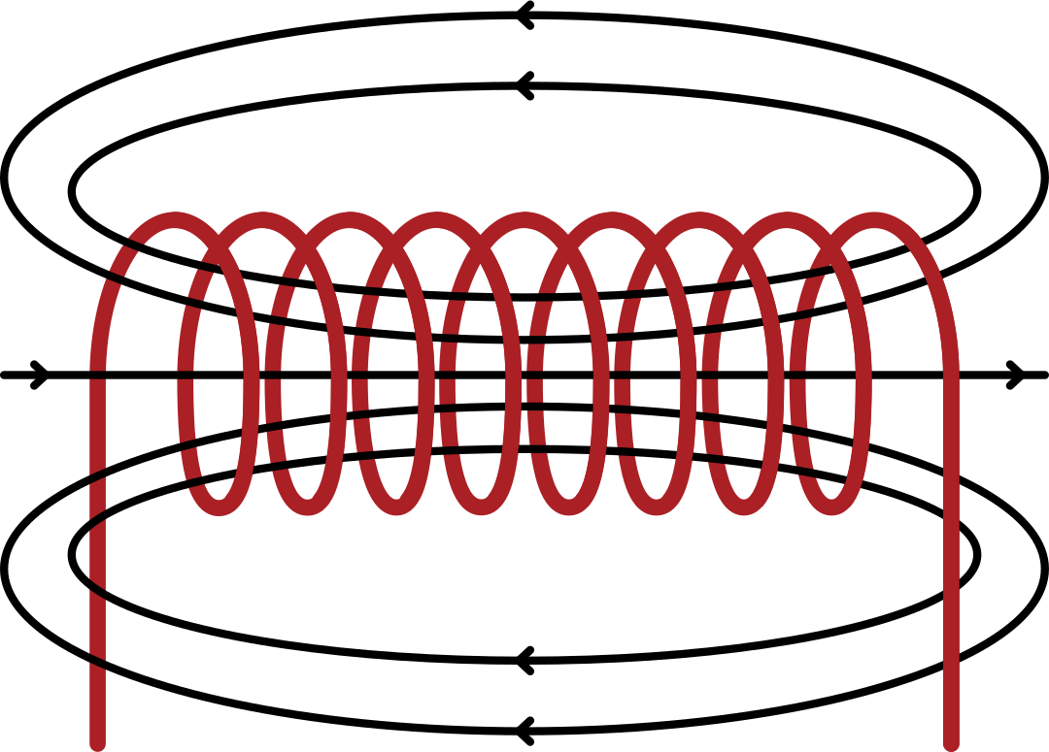
What is a solenoid ?
A solenoid is a long helical coil of wire through which a current is run in order to create a magnetic field. The magnetic field of the solenoid is the superposition of the fields due to the current through each coil. It is nearly uniform inside the solenoid and close to zero outside and is similar to the field of a bar magnet having a north pole at one end and a south pole at the other depending upon the direction of current flow.

Slide 6
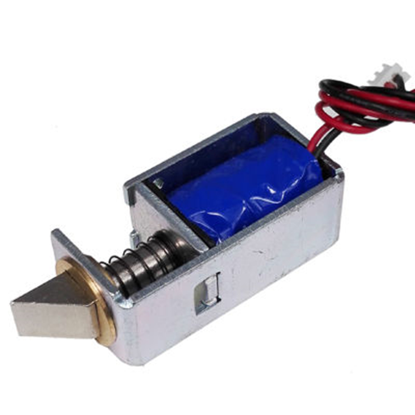
Working of a solenoid Lock
When an iron core is placed in the solenoid, it becomes magnetized and is drawn into the solenoid, compressing the spring and allowing the door to unlock. When the power supply is cut, the iron core demagnetizes, causing the spring to expand and pushing the iron core back out to lock the door

Slide 7
To open the door lock, we have to enter the correct password on the keypad.
Once we enter the correct password, the Arduino sends the signal to Relay Module
The Relay Module acts like a switch and allows the current to pass from the 12V battery to solenoid.
The door opens with one Beep and yellow LED Blink.
The door automatically close after a time interval of 3 seconds.
Model Explanation

Slide 8
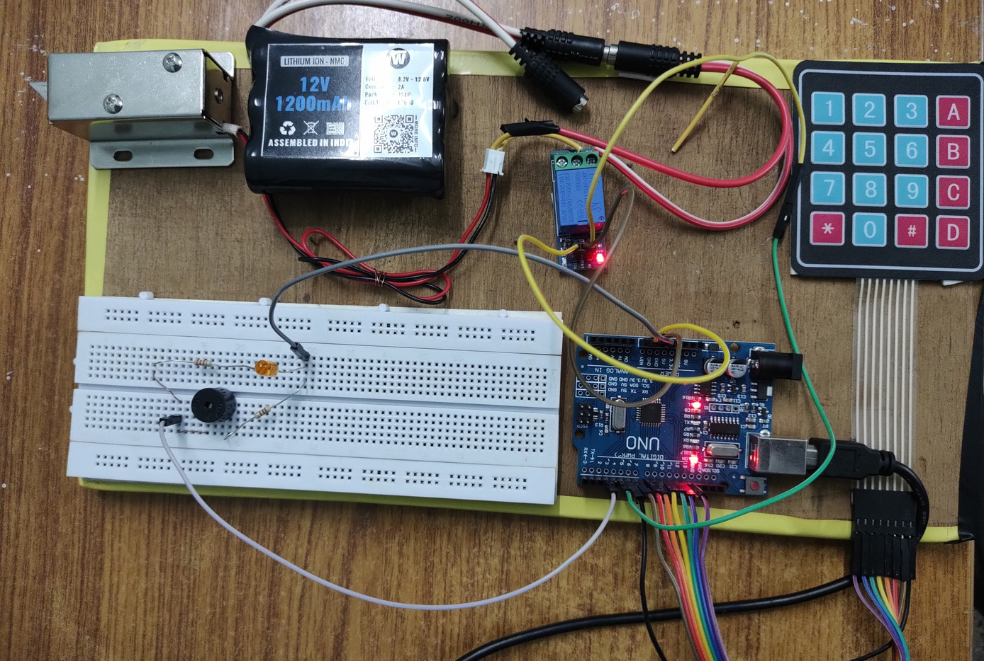
Now we have enhanced security by introducing alarm whenever someone enters wrong password.
So when the password entered is incorrect, the door remains closed and the Buzzer sounds and LED blinks 4 times continously.
Model Explanation

Slide 9
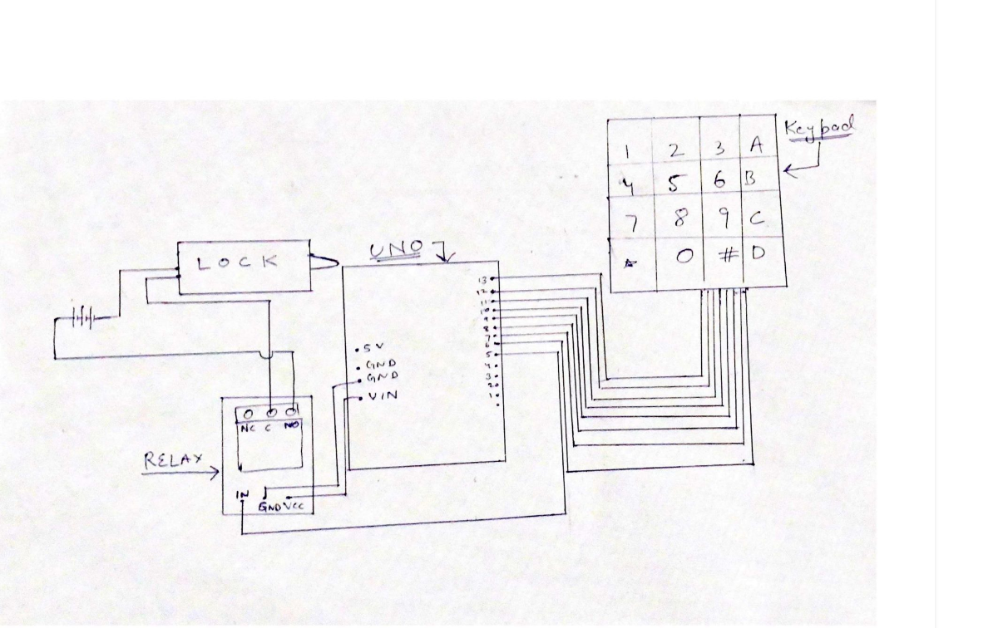
CIRCUIT DIAGRAM

Slide 10
There are certain situations that are very annoying like a person locks himself out of the house or the key to the door is lost. These kinds of situations always trouble people with manual locks.
Although in some places people use smart cards(RFID) but someone can lose the card.
That is when Password based automatic door lock system comes into play.
The main scope of application of the Automatic door lock security system is offices, warehouses, and home.
Scope

Slide 11

References
https://www.youtube.com/watch?v=BLrHTHUjPuw&t=2s
https://playground.arduino.cc/Code/Keypad/https://playground.arduino.cc/Code/Keypad/

Slide 12


